Slide 1

FLUID POWER LAB
Department of Mechanical Engineering,
Amrita School of Engineering, Coimbatore - 641112

Slide 2
INTRODUCTION
Fluid power is the technology that deals with the generation, control and transmission of forces and movement of mechanical element or system with the use of pressurized fluids in a confined system
Fluid power system includes a hydraulic system (hydra – water) and a pneumatic system (pneuma – air)

Slide 3
INTRODUCTION
Fluid system
Fluid power system
Hydraulics
Pneumatics
Fluid transport system

Slide 4
INTRODUCTION
Fluid transport systems
The delivery of a fluid from one location to another to accomplish some useful purpose
Examples include pumping stations for pumping water to homes, cross-country gas lines, etc
Fluid power systems
designed to perform work
work is obtained by pressurized fluid acting directly on a fluid cylinder or a fluid motor.
A cylinder produces a force resulting in linear motion, whereas a fluid motor produces a torque resulting in rotary motion

Slide 5
Advantages of Fluid Power System
Fluid power systems are simple, easy to operate and can be controlled accurately
Multiplication and variation of forces
Multifunction control
Low-speed torque
Constant force or torque
Economical
Low weight to power ratio
Fluid power systems can be used where safety is of vital importance

Slide 6
Disadvantages of Fluid Power System
Hydraulic oils are messy and leakage is impossible to eliminate
Hydraulic lines may burst, resulting in injuries to people due to high speed oil jets
Noise (emanating from pumps)
Fire accident due to leakage of hydraulic oil in the hot area of the equipment

Slide 7
Applications of Fluid Power System
Agriculture
Automation
Automobiles
Fabrication industry
Machine tools
Materials handling

Slide 8
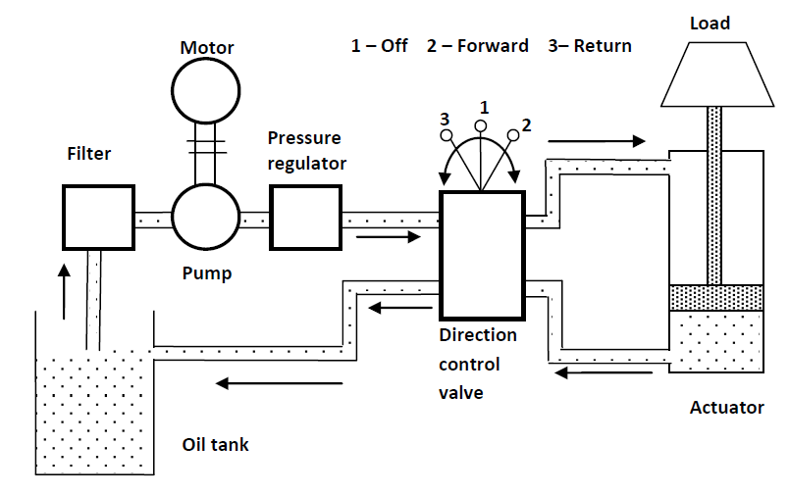
Basic Components of Hydraulic System
Components of Hydraulic system

Slide 9
Basic Components of Hydraulic System
Tank
Pump
Valves
DCV – Directional control valve
PCV – Pressure control valve
FCV – Flow control valve
Actuator
Cylinder / Motor
Piping
Filter
External power supply

Slide 10
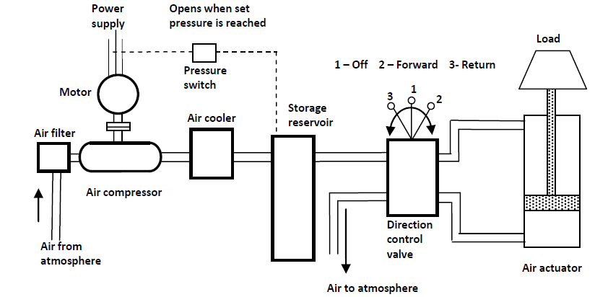
Basic Components of Pneumatic System
Components of pneumatic system

Slide 11
Basic Components of Pneumatic System
Compressor
Storage reservoir
FRL – Filter, regulator, lubricator
Valves
DCV – Directional control valve
PCV – Pressure control valve
FCV – Flow control valve
External power supply
Piping system
Actuator
Cylinder / Motor

Slide 12
Comparison between Hydraulic and Pneumatic Systems
Hydraulic System | Pneumatic System
It employs a pressurized liquid as a fluid | It employs a compressed gas, usually air, as a fluid
An oil hydraulic system operates at pressures up to 700 bar | A pneumatic system usually operates at 5–10 bar
Generally designed as closed system | Usually designed as open system
The system slows down when leakage occurs | Leakage does not affect the system much
Heavier in weight | Lighter in weight
Pumps are used to provide pressurized liquids | Compressors are used to provide compressed gases
The system is unsafe to fire hazards | The system is free from fire hazards
Automatic lubrication is provided | Special arrangements (FRL) for lubrication are needed

Slide 13
Symbols
Single acting cylinder
Double acting cylinder
2/2 Valve push button / spring
3/2 Valve push button / spring
2
12
10
1
12
2
10
3
1

Slide 14
Symbols valves
3/2 Valve differential pressure operated
5/2 Valve push button / spring
5/3 Valve double pressure operated spring centre
12
2
10
3
1
4
2
14
12
5
1
3
4
2
5
1
3

Slide 15
Symbols valves
A valve function is known by a pair of numbers e.g. 3/2. This indicates the valve has 3 main ports and 2 states
The valve symbol shows both of the states
when the valve is operated at the 12 end port 1 is connected to port 2
when reset to the normal state at the 10 end port 1 is connected to nothing (0)
2
12
10
3
1

Slide 16
Symbols valves
A valve function is known by a pair of numbers e.g. 3/2. This indicates the valve has 3 main ports and 2 states
The valve symbol shows both of the states
when the valve is operated at the 12 end port 1 is connected to port 2
when reset to the normal state at the 10 end port 1 is connected to nothing (0)
3-ports 2-position
Plunger-operated
Spring return
Direction Control Valve
3/2 way DCV
2
12
10
3
1

Slide 17
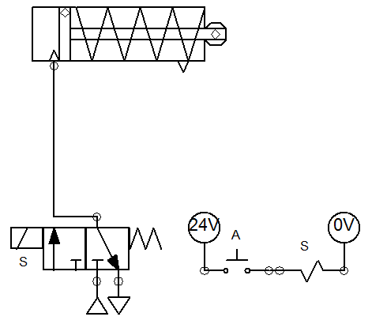

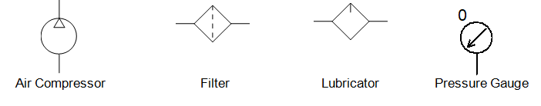
Symbols operators
Plunger
Pressure
Spring normally as a return
Pilot pressure
Roller
Differential pressure
Uni-direction or one way trip
Detent in 3 positions
Solenoid
Notes:
27

Slide 18
Actuator control 2/2 valve

Slide 19
2/2 Valve actuator control
A pair of the most basic of all valve types the 2/2 can be used to control a single acting cylinder
The normally closed position of the valve is actuated by the spring
The operated position is actuated by the push button
One valve admits air the other valve exhausts it
2
1
12
10
12
10
1
2
OUT
IN

Slide 20
2/2 Valve actuator control
The button marked OUT is pushed to operate the valve
Air is connected to the cylinder and it outstrokes
Air cannot escape to atmosphere through the valve marked IN as this is closed
The air at atmospheric pressure in the front of the cylinder vents through the breather port
2
1
12
10
12
10
1
2
OUT
IN

Slide 21
2/2 Valve actuator control
The push button of the valve marked OUT is released and it returns to a normal closed position
Air is now trapped in the system and provided there are no leaks the piston rod will stay in the outstroked position
If the load increases beyond the force exerted by the air the piston rod will start to move in
2
1
12
10
12
10
1
2
OUT
IN

Slide 22
2/2 Valve actuator control
The button marked IN is pushed to operate the valve
Air escapes and the piston rod moves to the instroked position
The push button must be held operated until the piston rod is fully in
Atmospheric air will be drawn in to the front of the cylinder through the vent port
2
1
12
10
12
10
1
2
OUT
IN

Slide 23
2/2 Valve actuator control
If the button marked IN is released the piston rod will remain in the instroked position
Any leaks in the installation can cause the piston rod to creep
2
1
12
10
12
10
1
2
OUT
IN

Slide 24
2/2 Valve actuator control
To control the speed of the piston rod, flow restrictors are placed in the pipes close to each of the valves.
Adjustment of the restrictors will slow down the flow rate thereby giving independent outstroke and instroke speed control
2
1
12
10
12
10
1
2
OUT
IN
Notes:
The flow regulators should be close to the push button valves. The reason for this is the pipework and valve cavity volume between the push button valves and their flow regulators act as small reservoirs. This will cause the movement to overrun after releasing each button.
If the flow regulators are placed the other side of the push button valves, the reservoir effect will cause a slight jump in the cylinder action when each button is first pushed.

Slide 25
2/2 Valve actuator control
By repeated operation of either button during movement the piston rod can be moved in small steps for approximate positioning
This will only be successful under slow speeds
2
1
12
10
12
10
1
2
OUT
IN

Slide 26
2/2 Valve actuator control
With any compressed air system that intentionally traps air, the potential hazard of this must be recognised
Unintended release or application of pressure can give rise to unexpected movement of the piston rod
A pressure indicator or gauge must be fitted to warn of the presence of pressure
2
1
12
10
12
10
1
2
OUT
IN

Slide 27
Actuator control 3/2 valve

Slide 28
3/2 valve actuator control
A 3 port valve provides the inlet and exhaust path and is the normal choice for the control of a single acting cylinder
In the normal position produced by the spring, the valve is closed
In the operated position produced by the push button the valve is open
The push button must be held down for as long as the cylinder is outstroked
12
2
10
3
1

Slide 29
3/2 valve actuator control
A 3 port valve provides the inlet and exhaust path and is the normal choice for the control of a single acting cylinder
In the normal position produced by the spring, the valve is closed
In the operated position produced by the push button the valve is open
The push button must be held down for as long as the cylinder is outstroked
12
2
10
3
1

Slide 30
3/2 valve actuator control
A 3 port valve provides the inlet and exhaust path and is the normal choice for the control of a single acting cylinder
In the normal position produced by the spring, the valve is closed
In the operated position produced by the push button the valve is open
The push button must be held down for as long as the cylinder is outstroked
12
2
10
3
1

Slide 31
3/2 valve actuator control
To generally slow the cylinder speed an adjustable bi-directional flow regulator or fixed restrictor can be used
The flow regulator setting will be a compromise as the ideal outstroke speed may not produce the desired results for the instroke speed
12
2
10
3
1

Slide 32
3/2 valve actuator control
To control the outstroke speed of a single acting cylinder without controlling the instroke speed, a uni-directional flow regulator is used
The flow into the cylinder closes the non return valve and can only pass through the adjustable restrictor
By adjusting the restrictor the outstroke speed of the cylinder can be set
12
2
10
3
1

Slide 33
3/2 valve actuator control
For independent speed control in each direction two flow regulators are required
Installed in opposite directions to each other
Upper regulator controls the outstroke speed
Lower regulator controls the instroking speed
12
2
10
3
1

Slide 34
3/2 valve actuator control
A 3 port valve provides the inlet and exhaust path and is the normal choice for the control of a single acting cylinder
In the normal position produced by the spring, the valve is closed
In the operated position produced by the push button the valve is open
The push button must be held down for as long as the cylinder is outstroked
12
2
10
3
1

Slide 35
Actuator control 5/2 valve

Slide 36
5/2 Valve actuator control
For a double acting cylinder the power and exhaust paths are switched simultaneously
When the button is pushed the supply at port 1 is connected to port 4 and the outlet port 2 connected to exhaust port 3. The cylinder moves plus
When the button is released port 1 is connected to port 2 and port 4 connected to port 5. Cylinder minus
-
+
4
2
14
12
5
1
3

Slide 37
5/2 Valve actuator control
For a double acting cylinder the power and exhaust paths are switched simultaneously
When the button is pushed the supply at port 1 is connected to port 4 and the outlet port 2 connected to exhaust port 3. The cylinder moves plus
When the button is released port 1 is connected to port 2 and port 4 connected to port 5. Cylinder minus
-
+
4
2
14
12
5
1
3

Slide 38
5/2 Valve actuator control
Independent speed control of the plus and minus movements
In most applications speed is controlled by restricting air out of a cylinder
Full power is developed to drive the piston with speed controlled by restricting the back pressure
-
+
4
2
14
12
5
1
3

Slide 39
5/2 Valve actuator control
Independent speed control of the plus and minus movements
In most applications speed is controlled by restricting air out of a cylinder
Full power is developed to drive the piston with speed controlled by restricting the back pressure
-
+
4
2
14
12
5
1
3

Slide 40
5/2 Valve actuator control
Valves with a spring return are mono-stable and need the operator to be held all the time that the cylinder is required in the plus position
Bi-stable valves will stay in the position they were last set
The lever valve example illustrated indicates a detent mechanism. The lever need not be held once the new position has been established
-
+
4
2
14
12
5
1
3

Slide 41
Manual control
Remote manual control of a double acting cylinder
Valve marked + will cause the cylinder to outstroke or move plus
Valve marked - will cause the cylinder to instroke or move minus
The 5/2 double pilot valve is bi-stable therefore the push button valves only need to be pulsed
-
+
4
2
14
12
5
1
3
12
2
12
2
10
10
+
3
1
-
3
1

Slide 42
Manual control
Remote manual control of a double acting cylinder
Valve marked + will cause the cylinder to outstroke or move plus
Valve marked - will cause the cylinder to instroke or move minus
The 5/2 double pilot valve is bi-stable therefore the push button valves only need to be pulsed
-
+
4
2
14
12
5
1
3
12
2
12
2
10
10
+
3
1
-
3
1

Slide 43
Manual control
Remote manual control of a double acting cylinder
Valve marked + will cause the cylinder to outstroke or move plus
Valve marked - will cause the cylinder to instroke or move minus
The 5/2 double pilot valve is bi-stable therefore the push button valves only need to be pulsed
-
+
4
2
14
12
5
1
3
12
2
12
2
10
10
+
3
1
-
3
1

Slide 44
Manual control
Remote manual control of a double acting cylinder
Valve marked + will cause the cylinder to outstroke or move plus
Valve marked - will cause the cylinder to instroke or move minus
The 5/2 double pilot valve is bi-stable therefore the push button valves only need to be pulsed
-
+
4
2
14
12
5
1
3
12
2
12
2
10
10
+
3
1
-
3
1

Slide 45
Manual control
Remote manual control of a double acting cylinder
Valve marked + will cause the cylinder to outstroke or move plus
Valve marked - will cause the cylinder to instroke or move minus
The 5/2 double pilot valve is bi-stable therefore the push button valves only need to be pulsed
-
+
4
2
14
12
5
1
3
12
2
12
2
10
10
+
3
1
-
3
1

Slide 46
Semi-automatic control
Manual remote start of a double acting cylinder with automatic return
Cylinder identified as “A”
Trip valve operated at the completion of the plus stroke identified as “a1”
-
+
a1
A
4
2
14
12
5
1
3
12
2
12
2
10
10
+
3
1
-
a1
3
1

Slide 47
Fully-automatic control
-
+
a0
a1
Continuous automatic cycling from roller operated trip valves
Manual Run and End of the automatic cycling
Cylinder will come to rest in the instroked position regardless of when the valve is put to End
Tags for the roller feedback valves a0 and a1 show their relative positions
A
4
2
14
12
5
1
3
2
10
12
Run/End
3
1
12
2
12
2
10
10
a0
3
1
a1
3
1

Slide 48
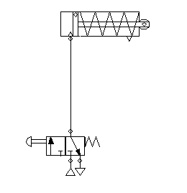
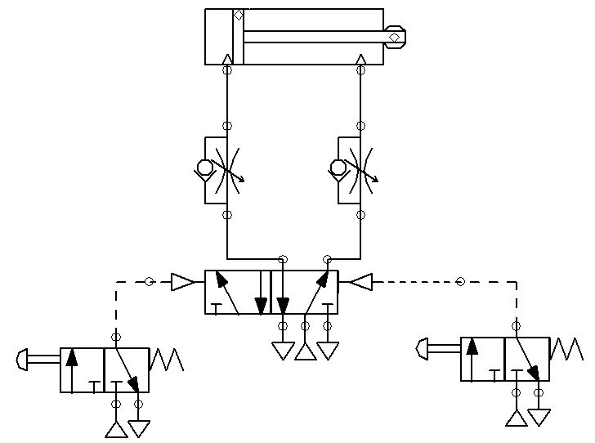
design & simulation of pneumatic system using single AND double acting cylinder
Single acting cylinder
double acting cylinder

Slide 49
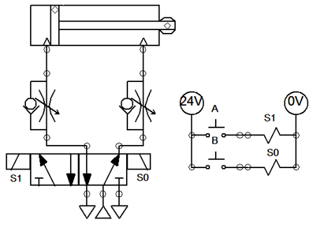
electro- pneumatic system
Single acting cylinder
double acting cylinder

Slide 50
Programmable Logic Controller PLC

Slide 51
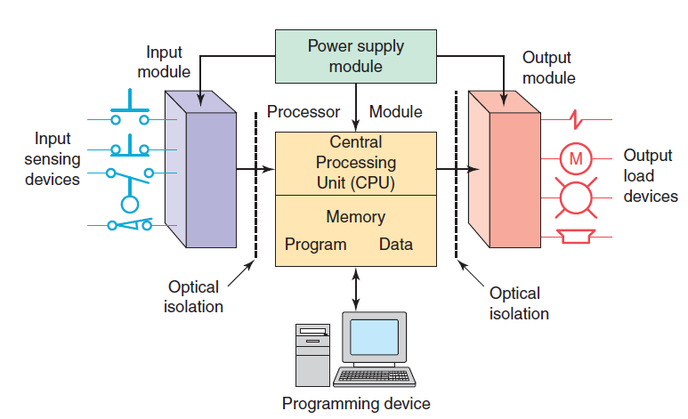
PLC – Block diagram / Architecture
A programmable logic controller (PLC) is an industrial grade computer that is capable of being programmed to perform control functions.

Slide 52
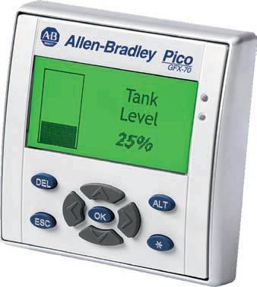
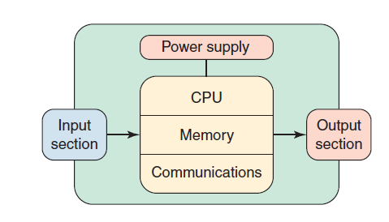
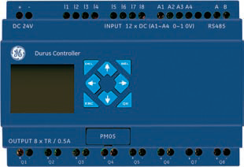

Slide 53
THANK YOU

